Slide 1
ANNOUNCEMENTS AND ROADMAP
Roberto Griggio & Enrico Fabris
Chief Executive Officer & Chief Technology Officer
12/04/2024

Slide 2
Where were we?
The areas covered are: Access Management and Identity Orchestration
The evolutionary steps were dictated by:
Conversations with various analysts
Analysis of competitors and the market
Customers and Prospects
New area: Identity Governance (IGA)
We already have some Light IGA functionalities
Notes:
PRIMO PUNTO: Dove eravamo rimasti?
Che gli ambiti di utilizzo di monokee possono essere categorizzate in due grandi macroaree, l’ambito access management e Identity Orchestration. La seconda facilita l’adozione dello strumento in diversi ambiti ma se dovessimo parlare di posizionamento dobbiamo necessariamente parlare di queste due categorie.
------------------------------------------------------------------------------
SECONDO PUNTO:
Chiaramente il prodotto non si è fermato. L’evoluzione è stata dettata da questi fattori: alcune chiacchiere con vari analisti del settore, vedere dove si stavano direzionando i competitor e soprattutto parlando con clienti e prospect. I primi chiedevano un estensione del campo d’azione, mentre i secondi ci chiedevano delle features che effettivamente non eravamo in grado di soddisfare
------------------------------------------------------------------------------
TERZO PUNTO:
Il nuovo ambito è l’Identity Governance and Administration. Ho messo full perchè in realtà funzionalità di tipo light il prodotto già lo erogava e ci ha permesso tra l’altro di prendere determinati clienti che avevano una necessità in quella direzione.
Vogliamo diventare Full IGA? Per ora no, siamo pronti a lasciare quel 10/15% di mercato che hanno delle necessità estremamente spinte in ambito governance
Nel mondo decentralizzato si parla molto di wallet, si parla di standard per identificare le identità e il formato delle credenziali, si parla inoltre dei protocolli di comunicazione nel passaggio di informazioni tra le vare entità.
La generazione delle credenziali deve però necessariamente arrivare dai dati in possesso degli issuer e la loro gestione deve appoggiarsi alle normali discipline di governance.

Slide 3

…a family of products
AM
vi

Slide 4

…a family of products
AM
vi
2.0
We are proud to announce
4.0
IGA

Slide 5

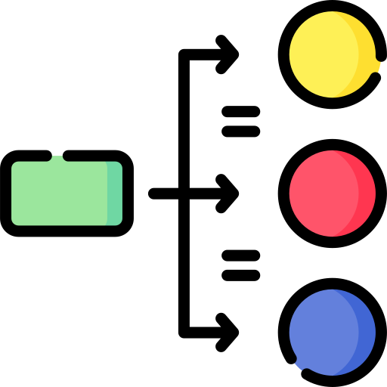



VIO 2.0
Long Life Task Support
Asynchronous and Synchronous Execution
IGA and IDM related nodes
Task Scheduler
Metadata-driven Custom Nodes Development
Notes:
IGA’s must-have capabilities: (https://www.gartner.com/document/code/775672?ref=authbody&refval=5071731)
Identity life cycle management
Access request process
Basic analytics and reporting
IGA’s standard capabilities:
Access certification (also called attestation or review)
Auditing
Policy and role management
Provisioning via automated connectors
Segregation of duties (SOD) controls
Workflow orchestration
Entitlement management capabilities (discovery, entitlement catalog management, entitlement data enrichment including descriptions, owners, risk ratings, etc.)
IGA’s optional capabilities:
Advanced analytics, to enable rapid improvements (role provisioning rule modeling/recommendations, SOD violations detection, access approval/certification recommendations, etc.)
Identity registration and profile management for identities/attributes not managed by HR source systems
Cloud infrastructure entitlement management (CIEM)
Ability to integrate with authorization tools to enable contextual decisions by sharing policy

Slide 6




IGA
Provisioning Engine
Identity Lifecycle
Certifications & Audit
Delegation
Notes:
IGA’s must-have capabilities: (https://www.gartner.com/document/code/775672?ref=authbody&refval=5071731)
Identity life cycle management
Access request process
Basic analytics and reporting
IGA’s standard capabilities:
Access certification (also called attestation or review)
Auditing
Policy and role management
Provisioning via automated connectors
Segregation of duties (SOD) controls
Workflow orchestration
Entitlement management capabilities (discovery, entitlement catalog management, entitlement data enrichment including descriptions, owners, risk ratings, etc.)
IGA’s optional capabilities:
Advanced analytics, to enable rapid improvements (role provisioning rule modeling/recommendations, SOD violations detection, access approval/certification recommendations, etc.)
Identity registration and profile management for identities/attributes not managed by HR source systems
Cloud infrastructure entitlement management (CIEM)
Ability to integrate with authorization tools to enable contextual decisions by sharing policy

Slide 7

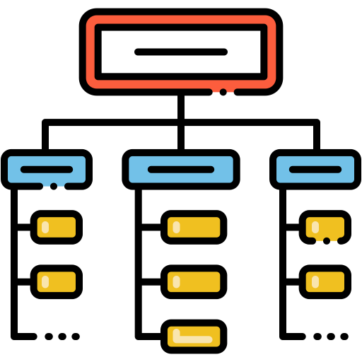







IGA: Provisioning Engine 1/3
Identity Connectors
SCIM Gateway
…and many others

Slide 8
IGA: Provisioning Engine 2/3
Connectors Direct Reconciliation
Identities Warehouse Based Reconciliation

Slide 9
IGA: Provisioning Engine 3/3
Scalable Web Socket Connectors Server

Slide 10

IGA: Provisioning Engine 3/3
Scalable Web Socket Connectors Server
Metadata-driven Custom Connectors Development

Slide 11









IGA: Identity Lifecycle Management
Joiner, Mover and Leaver
Roles & Entitlements Management
Access Requests with Approval Workflow
Applications Provisioning
Identities Warehouse with Attributes Management
Workflow (powered by 2.0)
vi

Slide 12



IGA: Certifications & Audit
Access and Attributes Certifications
Audit Events for Admin and Automatic Operations
IGA: Delegation
Fine Grained Delegation with Scope Restriction:

Slide 13
4.0
AM
vi
2.0
IGA
4.0
Available Q2 2024

Slide 14
future
AM
vi
2.0
What does the future hold for
IGA
?

Slide 15
…a family of products
AM
vi
2.0
IGA
API GW

Slide 16






roadmap
Identity Governance
Digital Signature
Fork SSI
Q2 / 2024
Q1 / 2025
Q3 / 2025
Q4 / 2024
Q2 / 2025
API Gateway
Behaviour Analytics through AI
CAEP
Notes:
Della parte di identity governance ne abbiamo abbondantemente parlato nelle slide precedenti. Come detto, attualmente il prodotto è pronto nella gran maggioranza delle funzionalità IGA e utilizzate già da alcuni clienti. Mancano alcune parti afferenti più alla sfera certificazione e auditing. Entro il Q3 / 2024 vorremmo tagliare il nastro.

Slide 17

roadmap
AM
vi
2.0
enables
IGA
API GW
Q4 / 2024
API Gateway
Behaviour Analytics through AI

Slide 18


roadmap
Third-party tools integrations:
Fraud Detection
Risk Analysis
Q4 / 2024
API Gateway
Behaviour Analytics through AI

Slide 19
roadmap
Identity Governance
Digital Signature
Fork SSI
Q2 / 2024
Q1 / 2025
Q3 / 2025
Q4 / 2024
Q2 / 2025
API Gateway
Behaviour Analytics through AI
CAEP

Slide 20
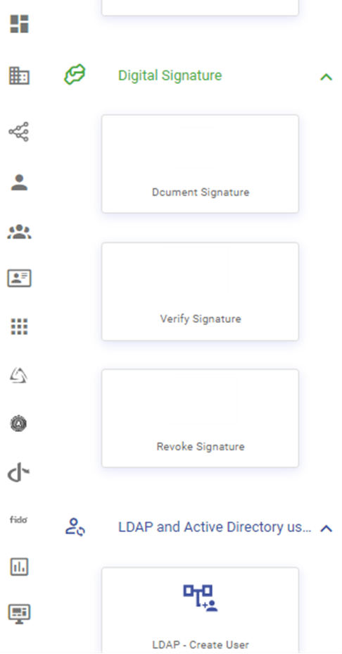




roadmap
Collaboration with
Digital Signature
Q1 / 2025

Slide 21
roadmap
Identity Governance
Digital Signature
Fork SSI
Q2 / 2024
Q1 / 2025
Q3 / 2025
Q4 / 2024
Q2 / 2025
API Gateway
Behaviour Analytics through AI
CAEP

Slide 22
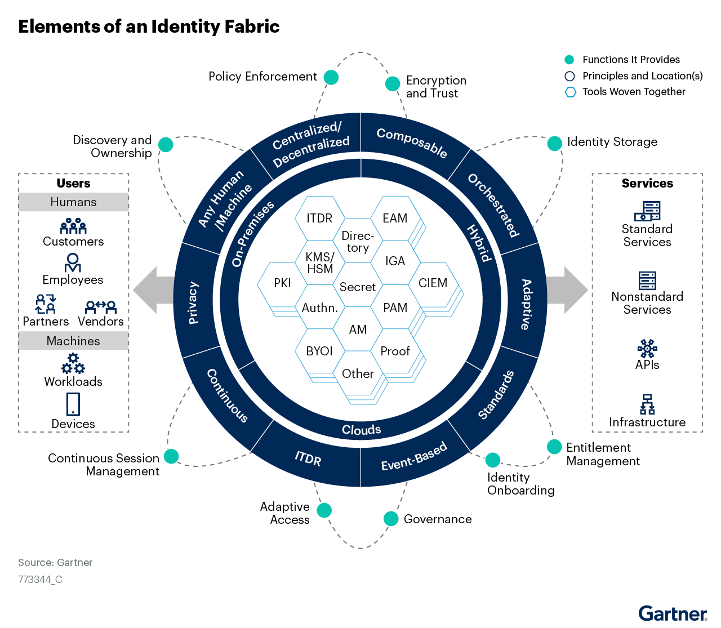
roadmap
CAEP is the application of the Shared Signals and Events Profile (SSE Profile) framework to ensure access security in a network of cooperating providers
Enabler for the implementation of an Identity Fabric
Q2 / 2025
CAEP
Notes:
Continuous Access Evaluation Profile (CAEP) is a standard that enables IAM, security tools and the services they protect to continually share security events to enable session management, mitigate breaches and to reenforce policies in a decentralized environment. CAEP profiles the Shared Signals and Events (SSE) Framework that defines mechanisms to communicate events between trusted parties to enable continuous runtime access decisions.
CAEP is the application of the Shared Signals and Events Profile of IETF Security Events 1.0 [SSE-FRAMEWORK] (SSE Profile) to ensure access security in a network of cooperating providers.

Slide 23
roadmap
Identity Governance
Digital Signature
Fork SSI
Q2 / 2024
Q1 / 2025
Q3 / 2025
Q4 / 2024
Q2 / 2025
API Gateway
Behaviour Analytics through AI
CAEP

Slide 24
roadmap
Fork SSI
Rebranding or packaging of a Decentralized Solution with focus on the following features:
Verifiable Credentials Management
Issuer and Verifier Flows
Centralized ←→ Decentralized Gateway
Q3 / 2025

Slide 25
Thank you for your attention

